Slide 1
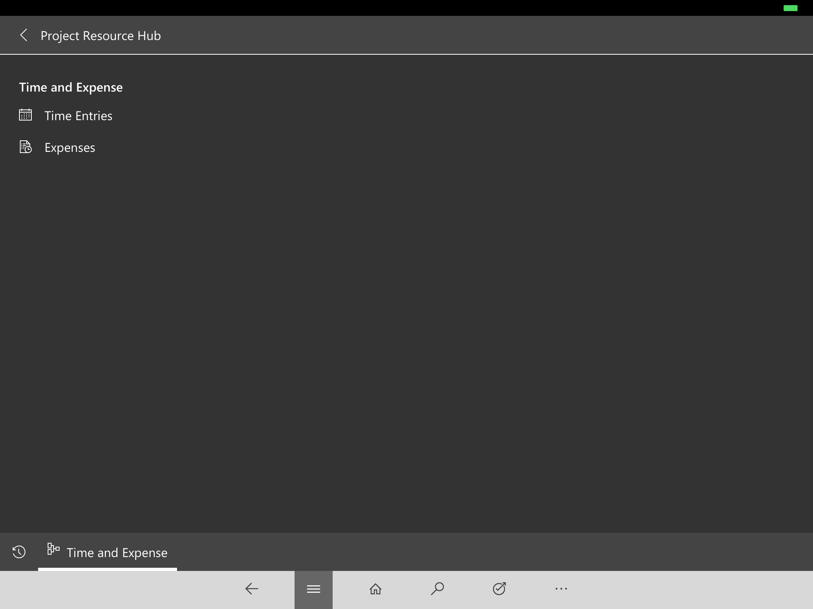
Work area
Navigation bar

